Slide 1
Optimally Locating Facilities on a Network
A Second Application of Transportation Network Analysis
Richard Larson
1.203J, 15.073J, IDS.700
November 27, 2017

Slide 2
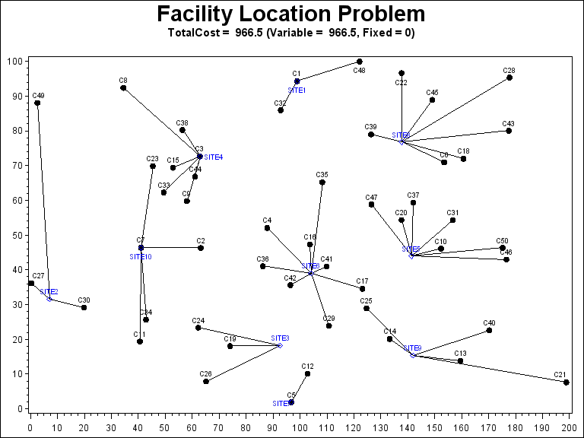

Slide 3
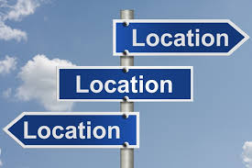

There Are Three Things Important When Buying a House:

Slide 4
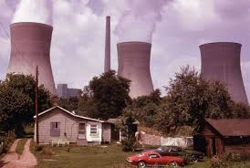
Maybe Not an Optimal Location!

Slide 5
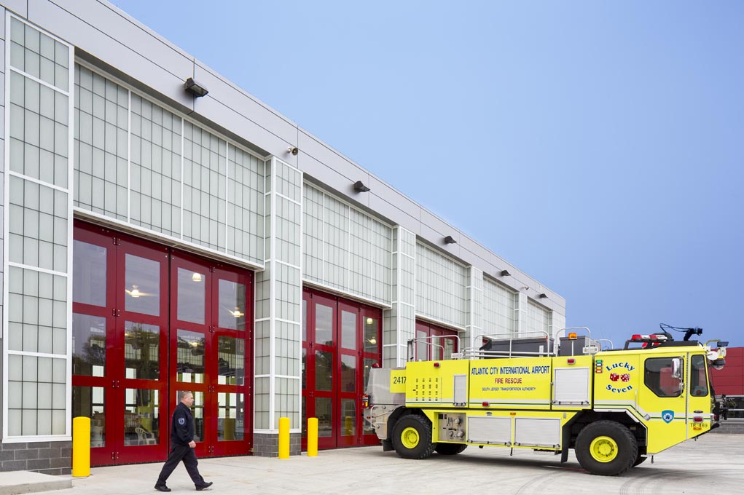
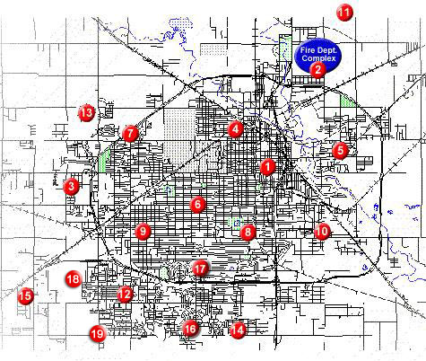

Slide 6

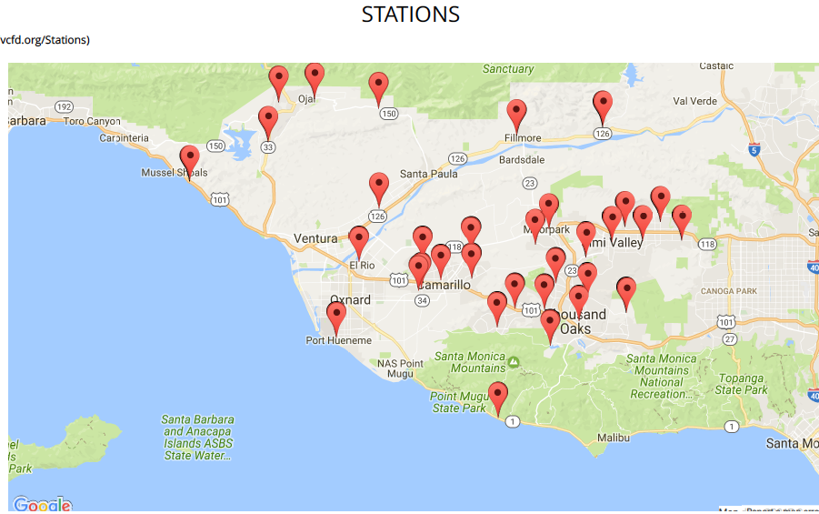

Slide 7
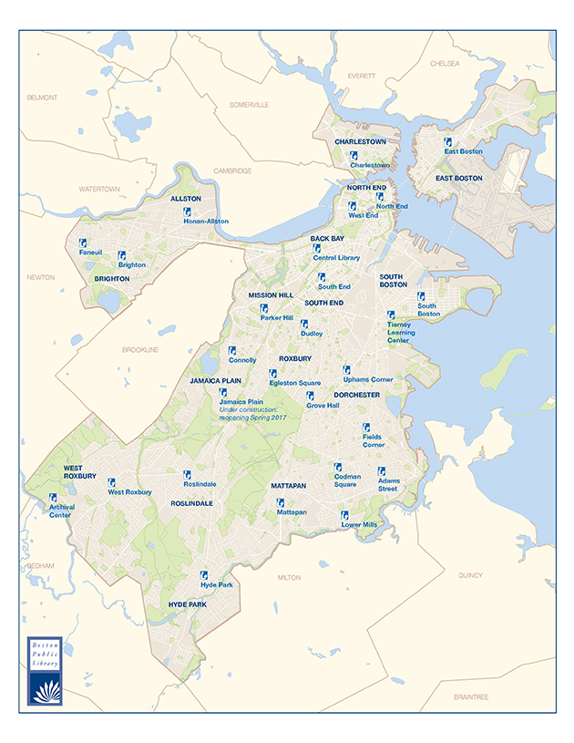
Locations of
Boston’s
Public Libraries

Slide 8
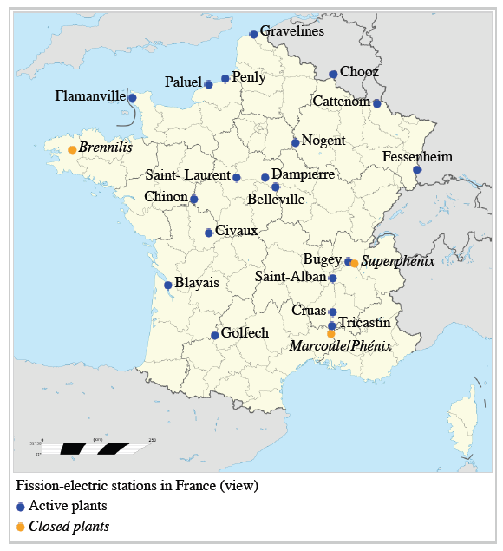
Locations of
Nuclear
Power
Plants
In France

Slide 9
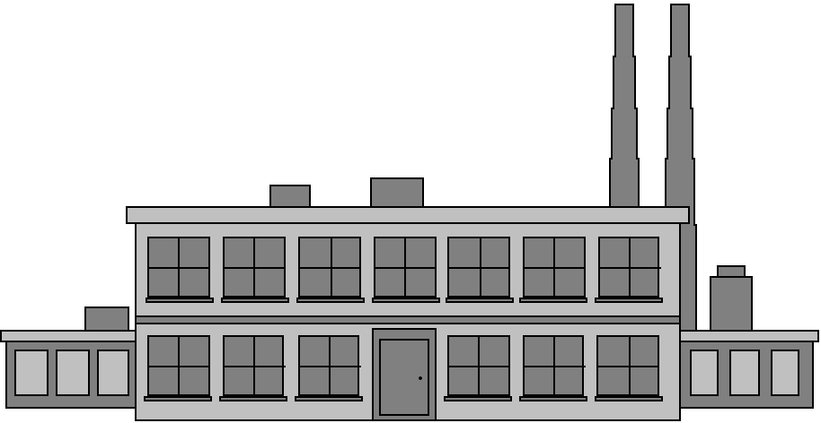
Other Examples:
Libraries
Ambulances
Warehouses
Factories
Restaurants
Banks
Telephone centers
Military facilities

Slide 10
Let’s Consider Objective Functions:
Minimize average travel time or distance
Minimize worst case (maximum) travel time or distance
Minimize fraction of population greater than 10 minutes from a facility
Maximize minimum travel time

Slide 11
Classic Location Problems
Median Problems
  Minimize average travel distance (time)
  Sometimes called Minisum
Center Problems
  Minimize maximum distance to (from) a facility
Requirements Problems
  Allocate to achieve some objective

Slide 12
Median Problem
Nodal weights h_{j}, representing fraction of customers from node j
Sum of h_{j}'s equals one.
We have an undirected network G(N,A)
Objective: locate k facilities on G such that mean travel distance to a closest facility is minimized

Slide 13
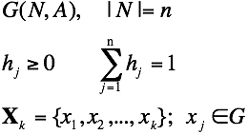
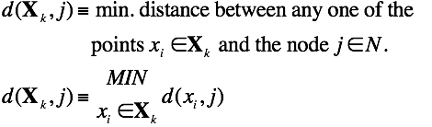
The network:
The nodal weights:
A set of
feasible locations:

Slide 14
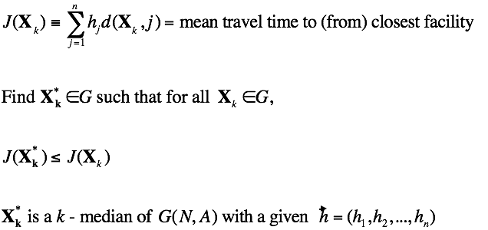
Objective function:

Slide 15
Theorem
At least one k-median exists solely on the nodes of G.

Slide 16
Proof by contradiction for k=1
Q=set of other network nodes
closer to x via node q
P=set of other network nodes
closer to x via node p
Q
P
d(x,p)
d(x,q)
p
q
x

Slide 17
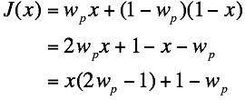
Proof
Start with 2-node problem, unit length link, w_{p} > w_{q,} .
x
1-x
p
q
x
>1, implies minimum at x=0

Slide 18
Case of w_{p} > w_{q} = 1- w_{p}
J(x)
1.0
w_{p}
1-w_{p}
0
1.0
x
Optimal Location

Slide 19
Case of w_{p} = w_{q} = 1- w_{p} = 1/2
J(x)
1.0
1/2
0
Optimal Locations
1.0
x

Slide 20
Case of w_{p} < w_{q} = 1- w_{p}
J(x)
1.0
1-w_{p}
w_{p}
0
1.0
x
Optimal Location

Slide 21
Proof - con't.
Add general multi-node network
  How does the argument change when the link we are focusing on is embedded within a general network?
Add breakpoints
  In general, will the set P and Q of nodes that are closer to x though exit nodes p and q, respectively, stay constant as we vary the value of x? Does the argument of the proof remain valid?

Slide 22
Example: Finding the 1-Median
1
2
4
1
2
3
2
2
1
2
5

Slide 23
Example: Finding the 1-Median
1
2
4
h₁=0.1
h₄=0.4
1
2
3
h₃=0.0
2
2
1
2
h₂=0.1
5
h₅=0.4

Slide 24
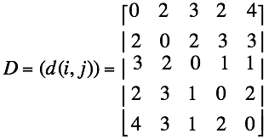
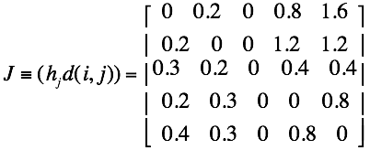
1
4
1. Find the travel distance matrix
2
h₁=0.1
h₄=0.4
1
2
3
h₃=0.0
2
2
1
h₅=0.4
2
h₂=0.1
5
2. Multiply j^{th} column by h_{j}
row sum
2.6
2.6
1.3
1.3
1.5
Answer!

Slide 25
Example: Finding the 1-Median
1
2
4
h₁=0.1
h₄=0.4
1
2
3
h₃=0.0
2
2
1
2
h₂=0.1
5
h₅=0.4

Slide 26
Example: Finding the 1-Median
1
2
4
h₁=0.1
h₄=0.4
1
Any purple
point is a
1-median
of this graph
2
3
h₃=0.0
2
2
1
2
h₂=0.1
5
h₅=0.4

Slide 27
Summary for 1-Median
Step 1: Find travel distance matrix D
Step 2: Find (h_{j} d(i,j))
Step 3: Find row sums of (h_{j} d(i,j))
  Take the (a) minimum

Slide 28
Center Problems
G(N,A), undirected
Locate one facility so as to minimize maximum distance to a node
Vertex center: facility must be at a node
Absolute center: facility may be anywhere on the graph

Slide 29
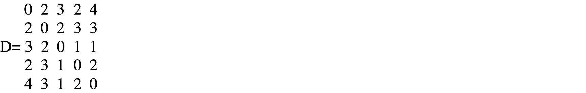
Recall our sample graph:
1
2
4
h₁=0.1
h₄=0.4
1
2
3
h₃=0.0
2
2
1
2
h₂=0.1
5
h₅=0.4
Nodes 2, 3 and 4 all vertex centers

Slide 30
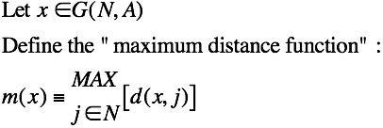
Absolute Center Problem
No nodal solution in general for the absolute center, only for the vertex center

Slide 31
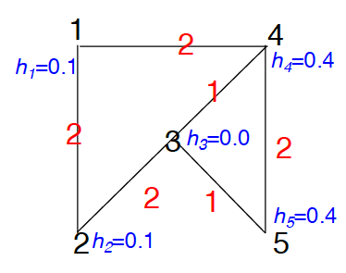
Let's Examine Link (3,4)
distance
m(x)=upper envelope
3
d(x,1)
d(x,2)
2
d(x,5)
1
d(x,3)
d(x,4)
0
1
x
Local center = 1/2

Slide 32
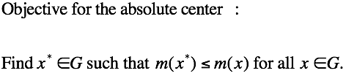

Slide 33
Single Absolute Center Algorithm:
1. Find all local centers (one for each link)
2. Choose a local center with smallest m(x_{l}). That is an absolute center x* of G.

Slide 34
Single Tree Center Problem
G is a tree. e_{i}, i=1,2,...,m
are the end vertices.

Slide 35
Single Tree Center Problem
e_{N}
Step 1: Choose any
and find the end vertex,
say e_{N}, farthest from x.
G is a tree. e_{i}, i=1,2,...,m
are the end vertices.
x

Slide 36
Single Tree Center Problem
e_{N}
Step 1: Choose any
and find the end vertex,
say e_{N}, farthest from x.
G is a tree. e_{i}, i=1,2,...,m
are the end vertices.
Step 2: Find the end vertex,
say e_{S}, farthest from e_{N}.
x
e_{S}

Slide 37
Single Tree Center Problem
e_{N}
Step 1: Choose any
and find the end vertex,
say e_{N}, farthest from x.
G is a tree. e_{i}, i=1,2,...,m
are the end vertices.
Step 2: Find the end vertex,
say e_{S}, farthest from e_{N}.
Step 3: The absolute center
of G is the midpoint
of the path from e_{N} to e_{S}.
The vertex center is the
vertex closest to
that midpoint.
x
e_{S}

Slide 38
Single Tree Center Problem
e_{N}
Step 1: Choose any
and find the end vertex,
say e_{N}, farthest from x.
G is a tree. e_{i}, i=1,2,...,m
are the end vertices.
Step 2: Find the end vertex,
say e_{S}, farthest from e_{N}.
Step 3: The absolute center
of G is the midpoint
of the path from e_{N} to e_{S}.
The vertex center is the
vertex closest to
that midpoint.
Absolute center
x
Vertex Center
e_{S}
(There is a single longest path.)

Slide 39
Median Facility Locations with Barriers and Manhattan Metric

Slide 40
Median Facility Locations with Barriers and Manhattan Metric
1/5
1/5
1/5
1/5
1/5

Slide 41
Median Facility Locations with Barriers and Manhattan Metric
1/5
1/5
1-median
1/5
1/5
1/5

Slide 42
Stochastic Queue Median
Stochastic Loss Median

Slide 43
Motivation
Standard Hakimi deterministic median
Lack of effects of uncertainty in time and duration of service request
Lack of queueing effects or lost customers
Queueing delay can be far greater than travel time

Slide 44
The Model
Single server queue garaged at
λh_{i} = Poisson rate of service requests from node i
Travel time = travel distance/speed = d/v
Time required to travel a fraction α of link (i,j) is (α)d_{ij}/v (d_{ij}= length of link)
S_{i}(x)=service time associated with node i

Slide 45
S_{i}(x)=service time associated with node i
Time
d(x,i)/v
R_{i}
(β-1)d(x,i)/v
W_{i}
Off-scene service time
Follow-up travel time
On-scene service time
Travel time to the customer

Slide 46
Potential Location of a Service Facility
x
a
b
x
l_{ab}-x

Slide 47
Model 1:
Stochastic Loss Median
When a customer requests service:
  Assign server to customer, if server is available
  Or, assign customer to a back-up system (i.e., customer is lost)

Slide 48
Model 2:
Stochastic Queue Median
Assume infinite capacity queue
When a customer requests service
  Assign server to customer, if server is available
  Otherwise enter the customer into a FCFS queue

Slide 49
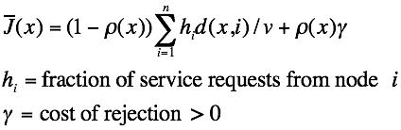
Model 1:
Stochastic Loss Median
ρ(x)=server utilization factor, when server is garaged at x
Expected cost of travel for a random service request is

Slide 50


Problem: Stochastic Loss Median
Find such that
Lemma: There exists at least one node of G
that is a stochastic loss median and that node
corresponds to the Hakimi median.
Proof requires that we show that is monotonically
increasing with mean travel time (or distance)

Slide 51
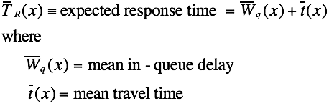
Model 2:
Stochastic Queue Median

Slide 52

Stochastic Queue Median:
Problem: we have breakpoints within links, as we have
already discussed in class. A breakpoint is a point that is
equidistant paths to a node, exiting the link on either end.
It is the point at which an optimal path to that node changes.

Slide 53
Algorithm
Can prove convexity of the objective function between breakpoints
Implies finite step algorithm for finding x*

Slide 54
x*(λ): Trajectory of the Optimal Location as a Function of λ
When λ = 0+, x* is an Hakimi median of G
When λ approaches λ_{max}-, then x* is again an Hakimi median of G
What happens in between extreme values of λ?

